Slide 1
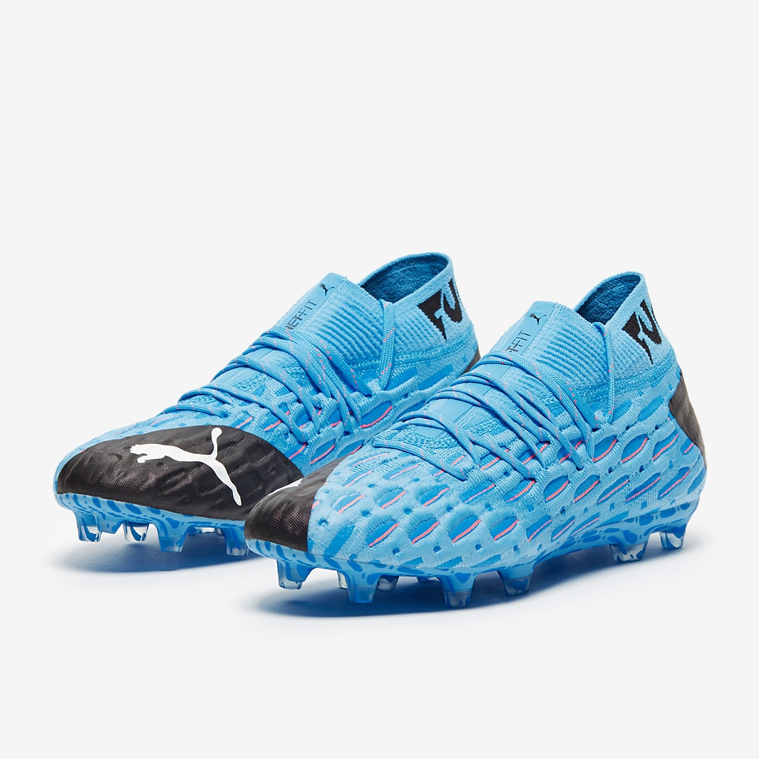
Recommend my soccer boots.
Haegang Yang

Slide 2
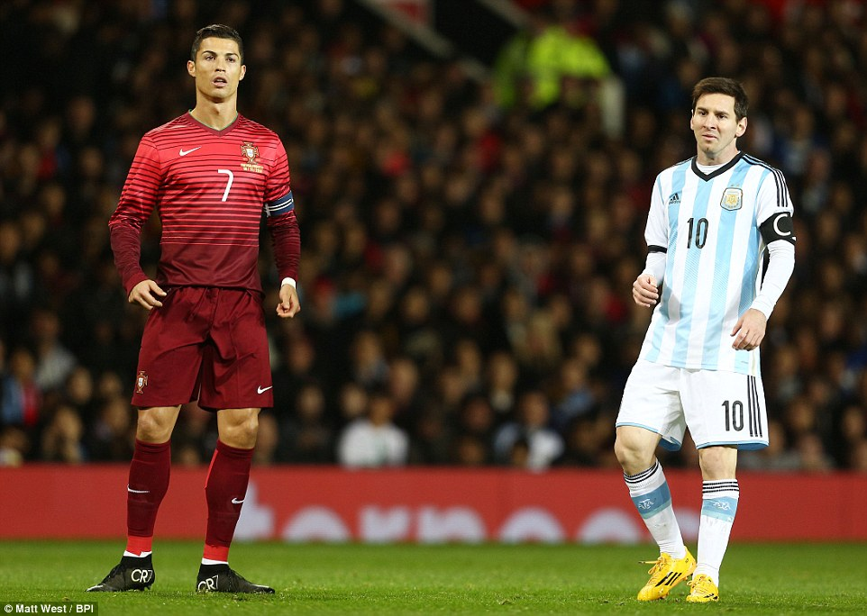
Messi uses adidas and Ronaldo uses nike

Slide 4
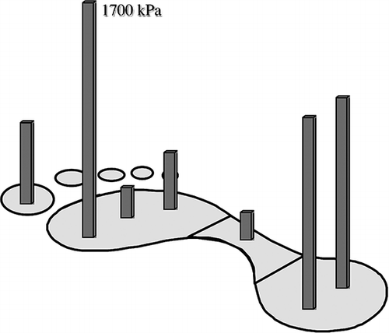
Shoe design ressures the different plantar pressure

Slide 6
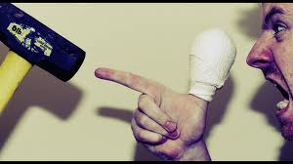
Bad workers always blame their tools

Slide 8
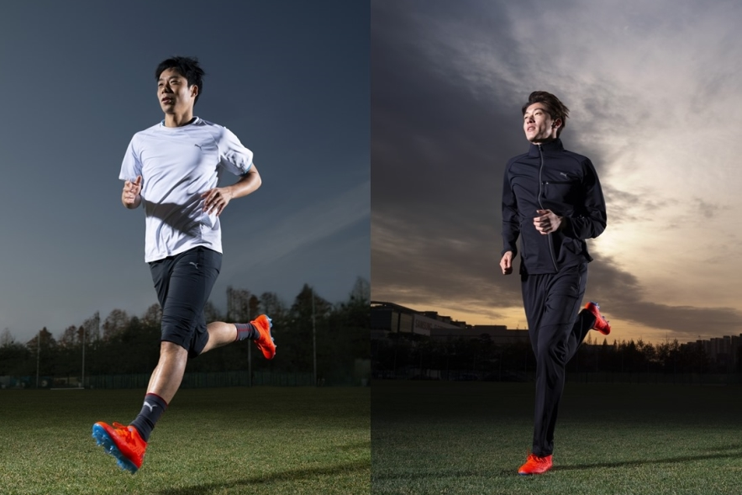
Many Asian soccer players use the wide feet due to the injury

